Slide 1
US CRAFT BEERS & BREWERIES
Bosang Yun & Bethel Kumsa
Notes:
Give context about where the dataset is from. The Beers dataset contains a list of 2410 US craft beers and Breweries dataset contains 558 US breweries.

Slide 2
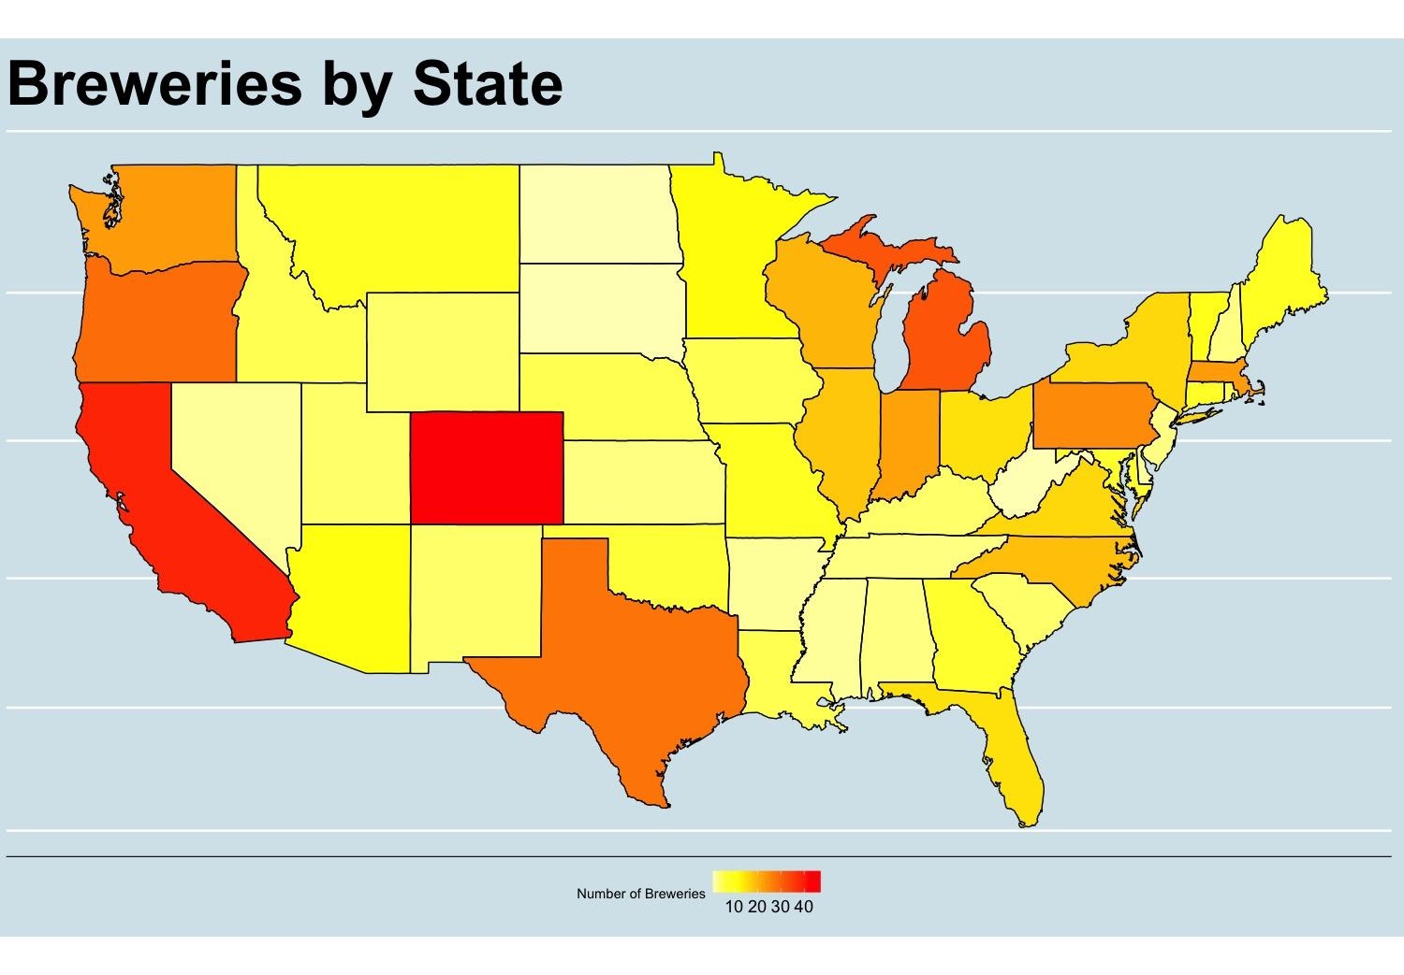
Breweries by state

Slide 3
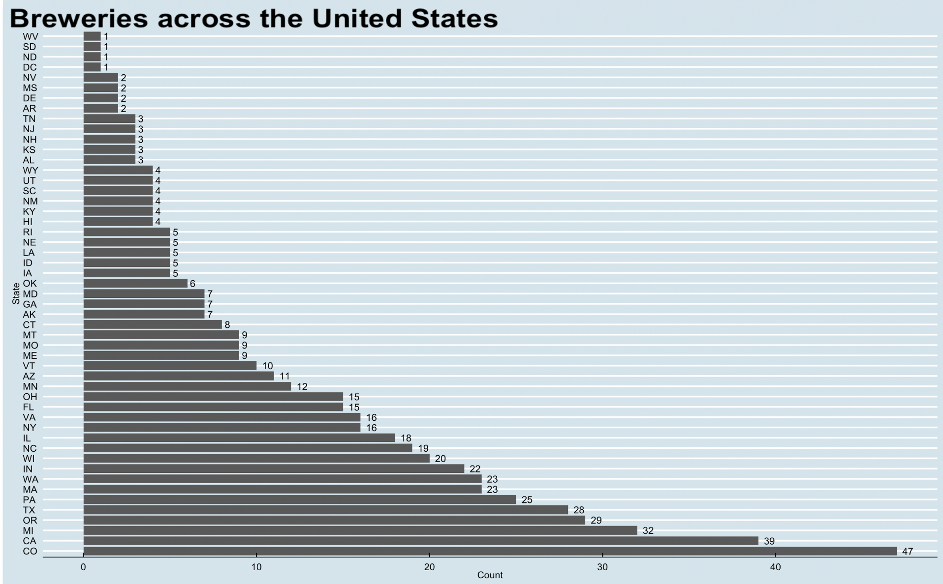
Breweries by state

Slide 4
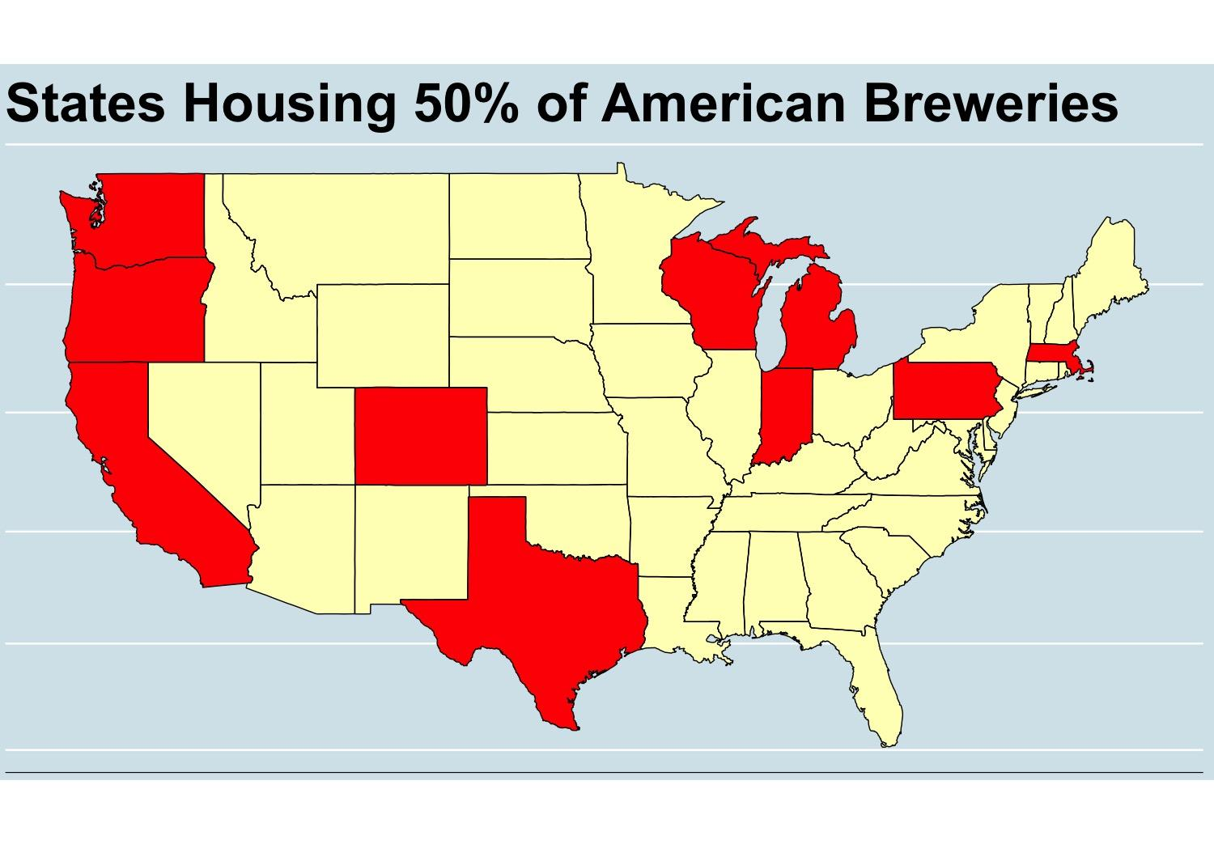
States housing 50% of American Breweries

Slide 5
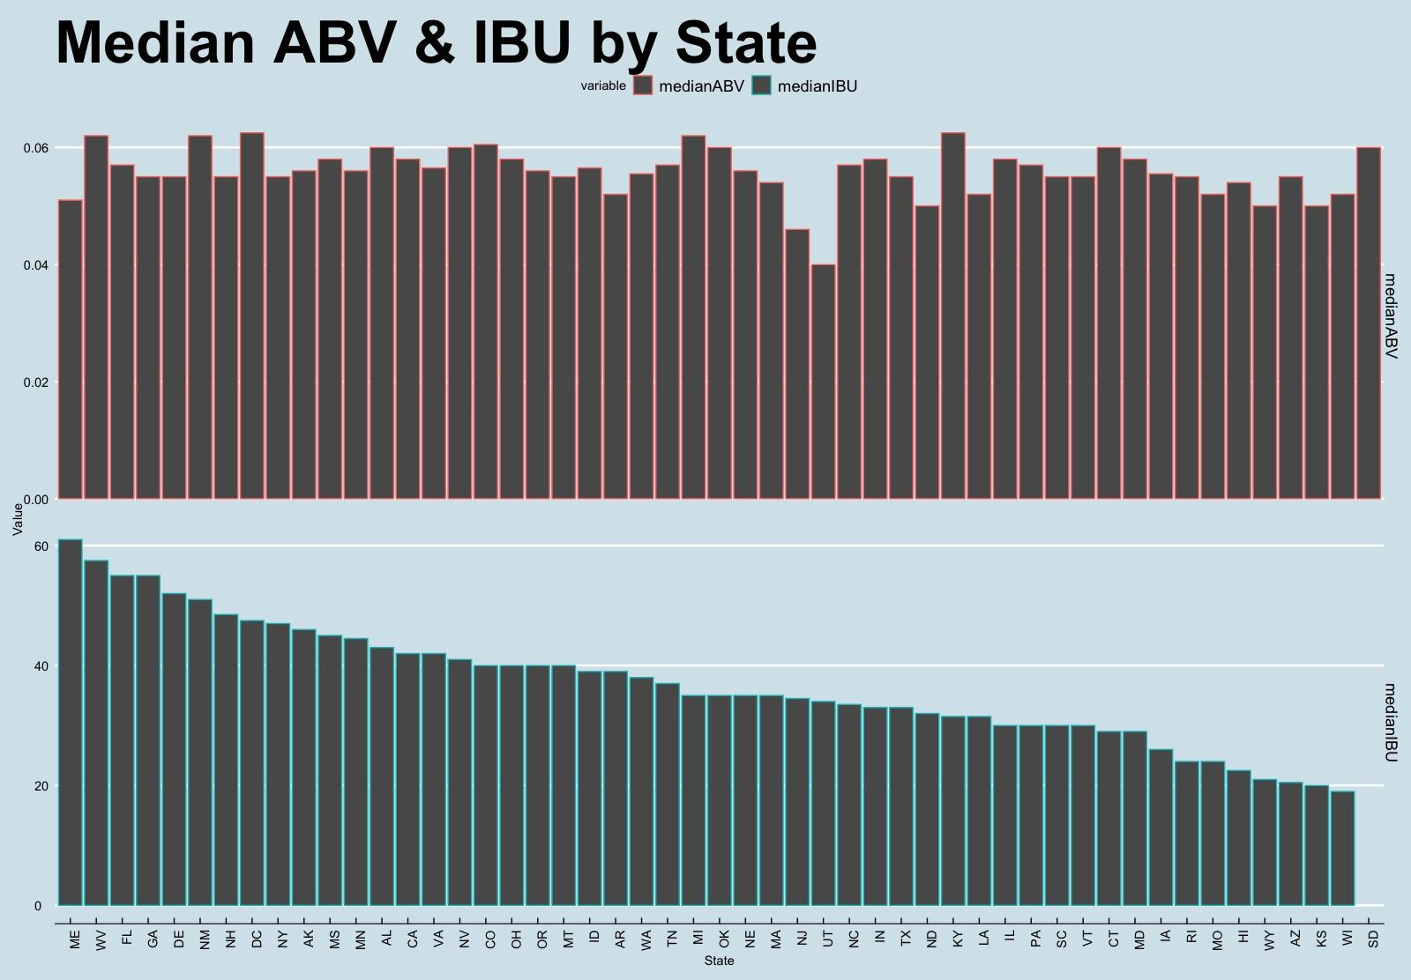
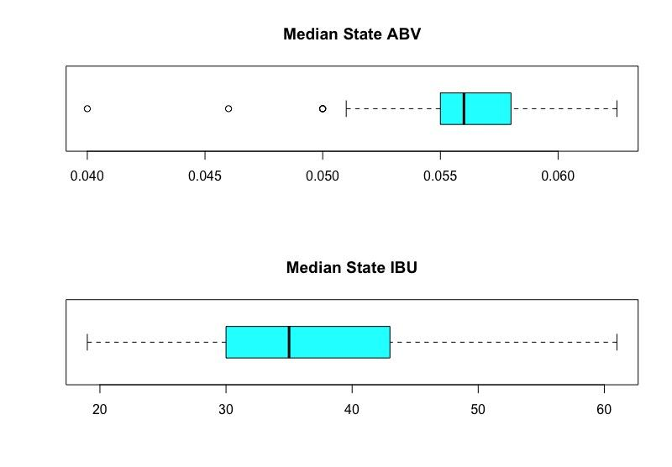
Median ABV % and IBU
Notes:
Oregon – Highest IBU
West Virginia – Highest Average IBU

Slide 6
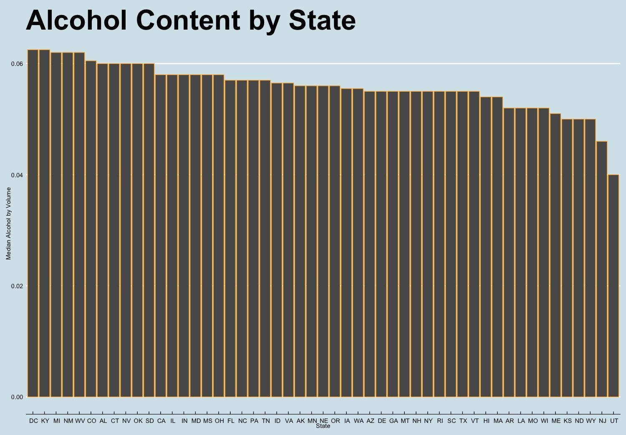
Alcohol content by state
Notes:
Colorado – Highest ABV | Belgian Style Quadrupel Ale
DC, KY – Highest Median ABV
In DC, 11% of all the adults are both heavy and binge drinkers. Not a alcohol permissive state. shaped by consumer behavior and habit
Kentucky bourbon ale - > high ABV content
UT - Anything over 4% is considered liquor. These not-beers are banned from grocery stores, taverns and only permitted in places with full liquor license.

Slide 7
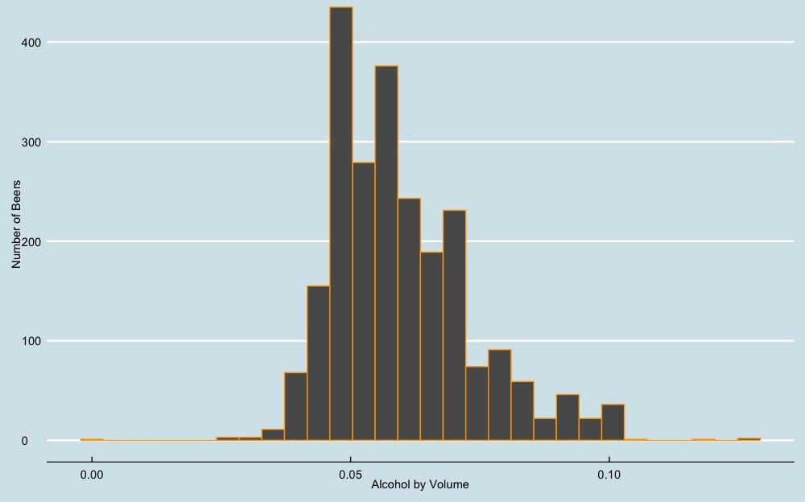
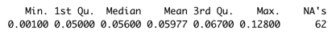
Distribution of ABV
Notes:
Missing values of ABV is not as bad as those of IBU that is over 1000. And this helped represent the distribution better than IBU

Slide 8
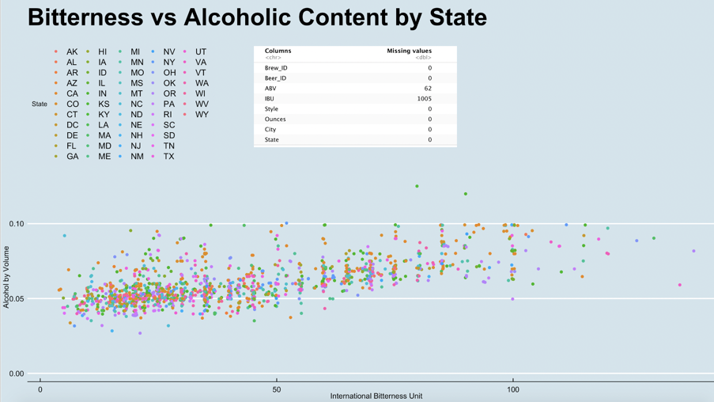
ABV vs IBU by state
Notes:
Explain the missing data points for IBU (1005) and ABV (62) with Bo’s interesting research about IBU changing with time.
General trend of linear relationship
1 IBU = 1mg/L of iso-alpha acids in solution
Once the beer leaves the laboratory, many factors such as hop components, roast character, carbonation, water chemistry, and residual sugar, all have influence on altering the IBU content. This makes IBU highly debatable at consumer level.

Slide 9
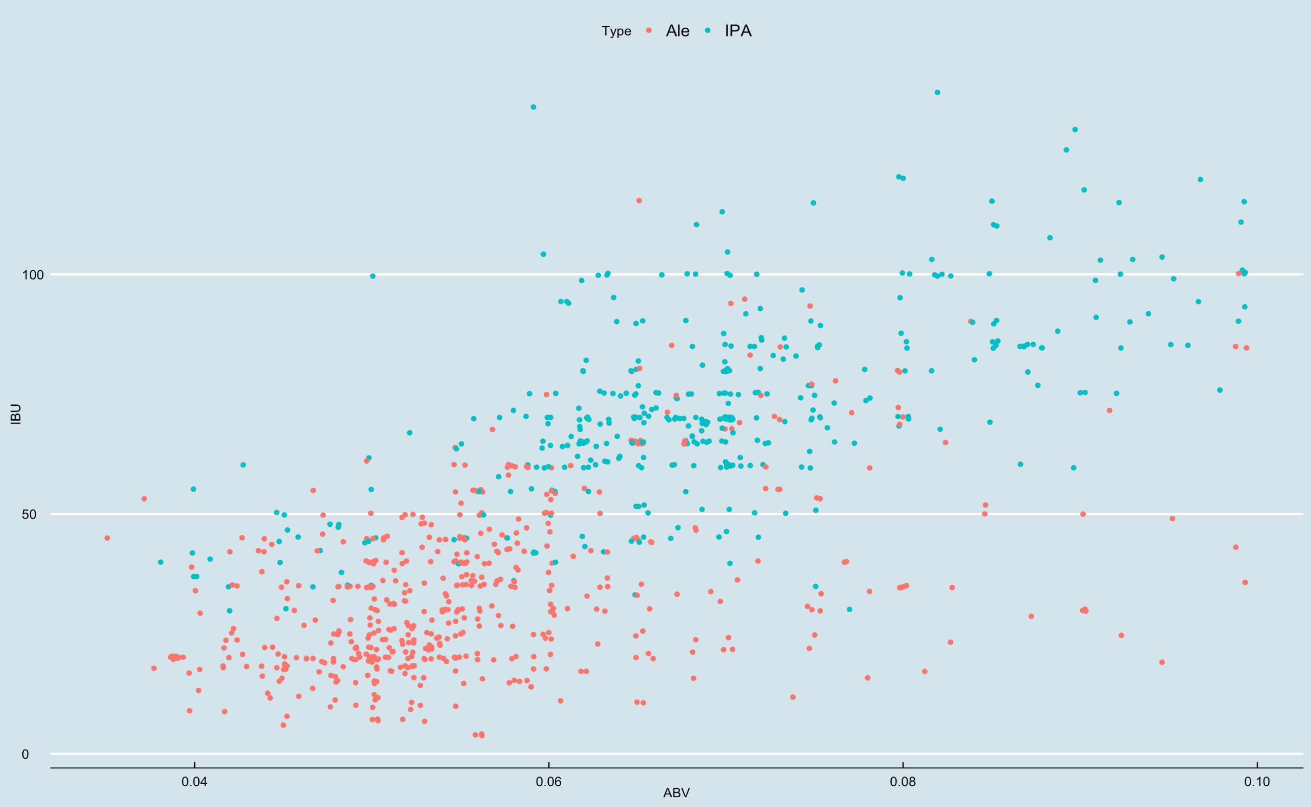
ABV vs IBU by beer type (Ale & IPA)

Slide 10
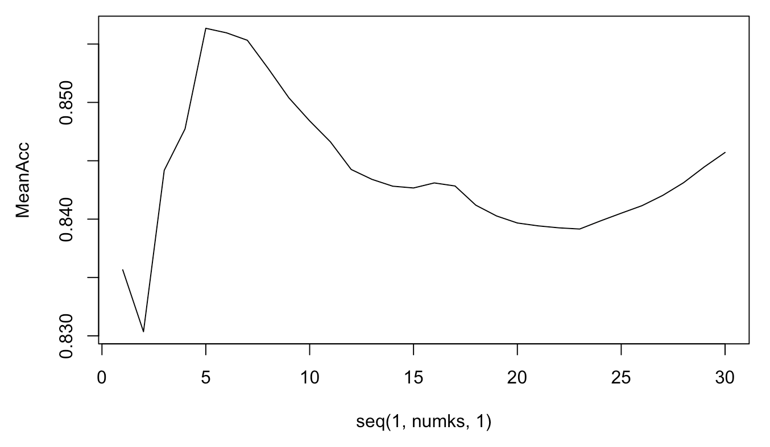
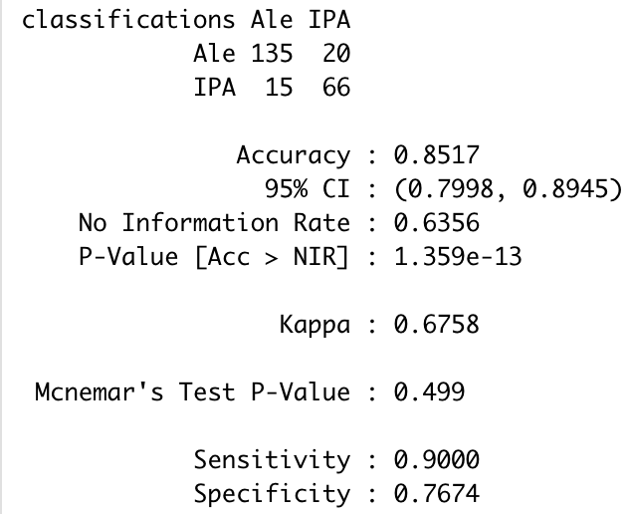
KNN Model
Model to predict the type of beer based on ABV and IBU
K value selection based on 500 repetition with 1-30 K values
K=5

Slide 11
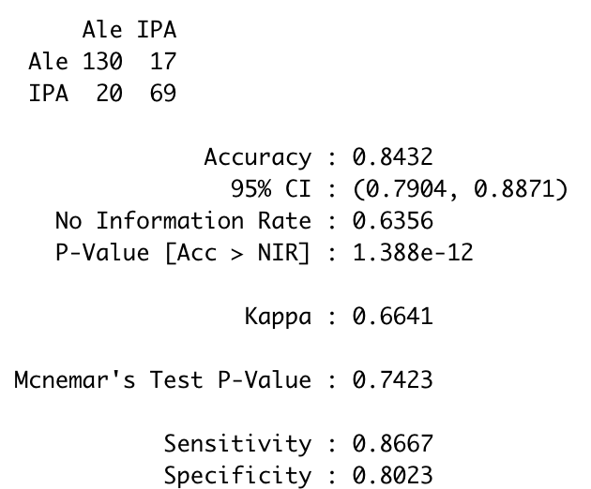
Naive Bayes Model
84.32% accuracy
Compared to KNN model, NB model results in a slightly less accurate prediction

Slide 12
Listing ABV of all Budweiser brands
Current Budweiser products
Bud Light : 4.2%
Budweiser : 5%
Bud Ice : 5.5%
Bud light lime : 4.2%
Average Budweiser ABV : 4.725%

Slide 13
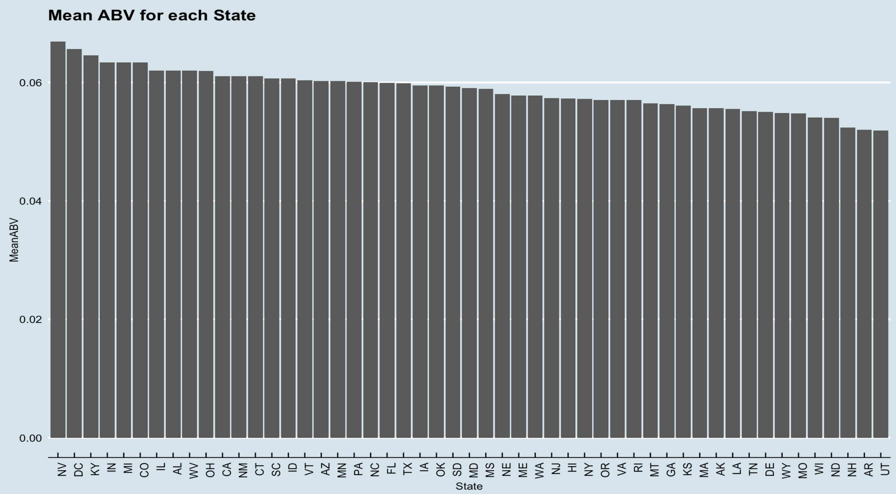
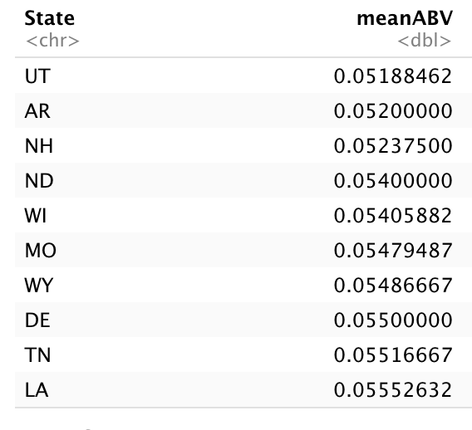
Mean ABV by state

Slide 14
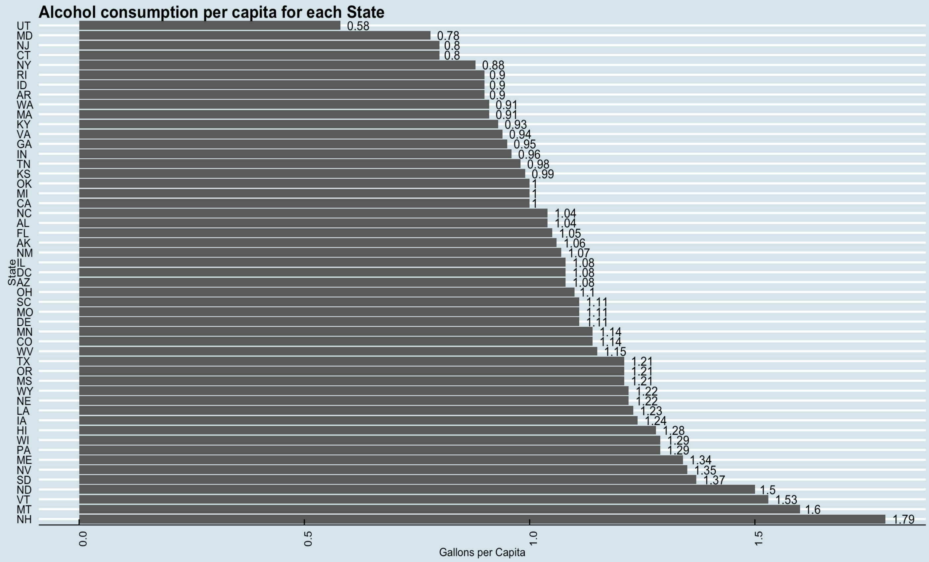
Alcohol consumption per capita by state

Slide 15
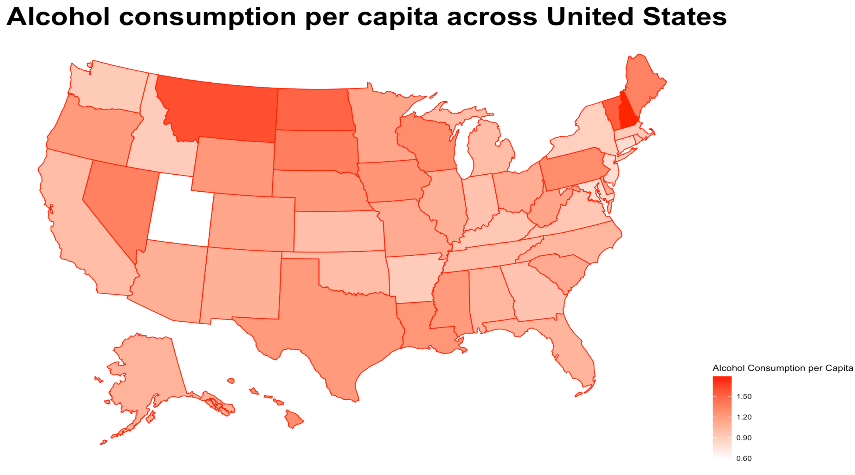
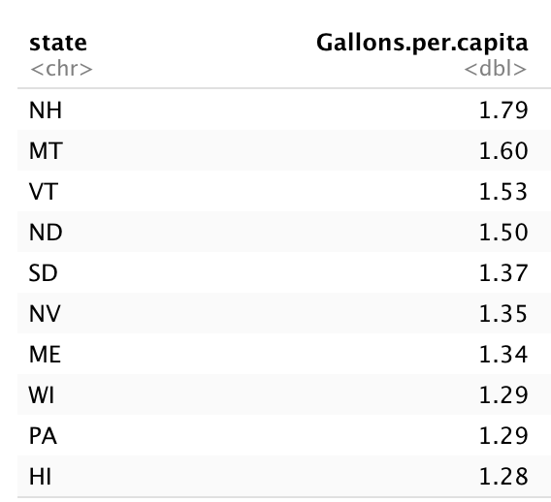
Alcohol consumption per capita by state
Notes:
#Midwesterners drink more beer than those in other regions, while Northeasterners drink the least. However, New Hampshire residents drink by far the most beer per capita of any state — likely due to the state’s unique lack of tax on alcohol. Meanwhile, Utah unsurprisingly drinks the least amount of beer per capita, as the predominantly Mormon state largely abstains from alcohol.

Slide 16
Investment Strategy
Based on state’s abv distribution and alcohol consumption per capita
New Hampshire
North Dakota
Wisconsin
- High alcohol consumption per capita
- Has low ABV %
- Has low # breweries, low competition
Notes:
#New Hampshire
Has highest alcohol consumption per capita
Has low ABV %,
Has only 3 breweries in the state
-> Very good market for Budweiser
#North Dakota
4th lowest ABV%
4th highest alcohol consumption
#Wisconsin
5th lowest ABV%,
9th highest alcohol consumption

Slide 17
Thank you for your time
Notes:
Give context about where the dataset is from. The Beers dataset contains a list of 2410 US craft beers and Breweries dataset contains 558 US breweries.

